Slide 1

Week 3 Project Update
Matthew Vu

Slide 2
Overview: Updates Made to Project
1. Altered topic and changed what the final product (application) is supposed to do
2. Better justification for doing my capstone project
3. Better explained how my project introduces new ideas
4. Explored and found data to be used
5. Brainstormed future plans
6. Created more comprehensive slides
Notes:
So before I get started on going into detail on some of the changes I made to the overall project topic and plan based on feedback from last class, I would like to give an overview on some of these changes. First, I changed the topic slightly, but more specifically changed what the final application is supposed to do. Second, I altered the topic and the end-goal final product because I wanted to create an application that is actually more useful and has better justification for making it. Third, I revised my literature review section to give better explanation of how my project introduces new ideas. Fourth, I explained, found, and cleaned data that is to be used for my project, which was a rather long process and I’ll explain why later. Fifth, I brainstormed future plans. Finally, I created more comprehensive slides.

Slide 3
Altered topic, end-goal, and motivations
Topic:
To create an application that can take in a single health record or series of health records (found in a relational database or table) from a health system database and output which patients are at risk of contracting diabetes using machine learning.
End Goal:
To write a report and experiment with logistic regression, naïve bayes, support vector machines, k-nearest neighbor, and decisions trees to see which machine learning algorithm can best predict diabetes.
To use the best machine learning algorithm in the application that will take in a single health record or a series of health records (like in a relational database or table) from a health system database and output which patients are predicted to have diabetes.
Motivations:
According to the Centers for Disease Control and Prevention, as of September 30, 2022, "more than 37 million people in the United States have diabetes, and 1 in 5 of them don’t know they have it" (CDC, 2022).
The application will help health systems know which patients are at-risk of diabetes, en masse or individually, and allow health systems to make calls or notifications recommending patients to schedule official diabetes screening. As a result, the application will help make the early detection of diabetes easier and speed up health records analysis.
Next Slide: End Goal Application Concept ->
Notes:
The overall topic of using machine learning to predict patients with diabetes is still the same; however, what the application is supposed to do is changed. So, the application that I will create will be designed to take in a series of health records (like from a relational database in the form a table) from a health system database and output which patients are at risk of contracting diabetes using a machine learning algorithm. Also, the end-goal of this entire project is to experiment with 5 machine learning algorithms, such as logistic regression, naïve bayes, support vector machines, k-nearest neighbor, and decision trees in order to investigate which one performs the best for this particular objective. In the end, the best algorithm will be used in the application. As for some reasons why I making this application is, as mentioned before in last class, many individuals have diabetes, but do not know that they have diabetes. As a result, by making this application those who are predicted by the application to have diabetes can be labeled as “at-risk” and called by the healthcare system to which their records reside and be recommended for an actual diabetes screening. Doing so, will help patients be warned that they are at-risk of diabetes, thus aiding in its early detection. Furthermore, an additional benefit of this application is multiple patients’ records can be analyze, thus allowing for a quick overview of which paitients need help. On the next slide, I will go over what the application will look like.

Slide 4
Diabetes Risk Application
Insert Health Records Here:
At Risk:
Patient ID | Last Name | First Name | Phone Number | At Risk
1 | Martinez | Lauren | 123-213-2132 | TRUE
2 | Pierce | Rachel | 505-764-0884 | TRUE
3 | Reilly | Megan | 305-770-9288 | TRUE
4 | Nguyen | Rachel | 413-929-0279 | TRUE
5 | Galvan | Ray | 505-646-4812 | TRUE
6 | McMillan | Jill | 218-720-5878 | TRUE
7 | Strickland | May | 505-811-3777 | TRUE
Click Here to Import
Notes:
So Here is the concept art of what the application will look like at the end. In the app, there will be a icon where you can click on to import a table consisting of health records like from a relational database or a spreadsheet. Also, after you import the health there will be an output of the patients who are predicted or “at risk” of diabetes. Afterwards, these patients can be called to schedule an actual diabetes health screening, evident in the output displaying their numbers. These calls can either be done manually or an automatic caller.

Slide 5
Example Health Records Input:
Patient ID | Last Name | First Name | Phone Number | Cholesterol | Glucose | HDL Chol | Chol/HDL ratio | Age | Gender | Height | Weight | BMI | Systolic BP | Diastolic BP | waist | hip | Waist/hip ratio
1 | Martinez | Lauren | 123-213-2132 | 193 | 77 | 49 | 3.9 | 19 | female | 61 | 119 | 22.5 | 118 | 70 | 32 | 38 | 0.84
2 | Pierce | Rachel | 505-764-0884 | 146 | 79 | 41 | 3.6 | 19 | female | 60 | 135 | 26.4 | 108 | 58 | 33 | 40 | 0.83
3 | Reilly | Megan | 305-770-9288 | 217 | 75 | 54 | 4 | 20 | female | 67 | 187 | 29.3 | 110 | 72 | 40 | 45 | 0.89
4 | Nguyen | Rachel | 413-929-0279 | 226 | 97 | 70 | 3.2 | 20 | female | 64 | 114 | 19.6 | 122 | 64 | 31 | 39 | 0.79
5 | Galvan | Ray | 505-646-4812 | 164 | 91 | 67 | 2.4 | 20 | female | 70 | 141 | 20.2 | 122 | 86 | 32 | 39 | 0.82
6 | McMillan | Jill | 218-720-5878 | 170 | 69 | 64 | 2.7 | 20 | female | 64 | 161 | 27.6 | 108 | 70 | 37 | 40 | 0.93
7 | Strickland | May | 505-811-3777 | 149 | 77 | 49 | 3 | 20 | female | 62 | 115 | 21 | 105 | 82 | 31 | 37 | 0.84
Notes:
Here is an example relation or table that can be imported into the app. As you can see in the blue, these are the candidate predictor variables that are used in the algorithm. You can imagine a unskilled individual just taking measurements and putting data into a computer and spitting out who is at risk of diabetes.

Slide 6
Academic Literature Review: Source 1
Title: “The Diabetes Risk Score: A practical tool to predict type 2 diabetes risk”
Summary: The paper describes the methodology behind the creation of their online health questionnaire to provide a diabetes risk score. They used a 1992 sample of Finnish subjects to train a logistic regression model to predict a diabetes risk score.
Ways I can see improvement in the app and research: The data is old (31 years old). Although logistic regression can be very good for understanding your data and making predictions, other algorithms make do a better job at making predictions. As a result, many more algorithms could possibly used.
Ways my project introduces new ideas: I will use more recent 2019 data and other algorithms in addition to logistic regression. Also, my application will not be a questionnaire that a person fills out individually. Instead, my application takes in health records, either for an individual or a set of individuals, and outputs who is at risk of diabetes.
Citation: Lindström J., & Tuomilehto, J. (2003). The Diabetes Risk Score: A practical tool to predict type 2 diabetes risk. Diabetes Care, 26(3), 725–731. https://doi.org/10.2337/diacare.26.3.725
Notes:
So, the actual sources of previous academic literature has not changed; however, my explanations if how my project and application introduces new ideas is modified. Well, the first piece of literature by Jaana Lindström and Jaako Tuomilehto, as we saw from last class describes their methods and process of creating a web-based questionnaire that asks very simple questions to output a diabetes risk score. Now, my project introduces new ideas and improves on some methods in this piece of literature because I will first use more up-to-date data, from 2019, which is much more recent than 1992 data that was used in the application from this first piece of academic literature. Also, I will second experiment with multiple algorithms, not just logistic regression, and my application will have the ability to take in a table/relation of health records of multiple or individual patients and output who is at risk of diabetes.

Slide 7
Academic Literature Review: Source 2
Title: "Pima Indians diabetes mellitus classification based on machine learning (ML) algorithms“
Summary: The article describes using multiple machine learning algorithms, such as naïve bayes, random forests, and decision trees to predict diabetes using a dataset consisting of data points for Pima Tribe Native Americans from 1990.
Ways I can see improvement: Explore more algorithms using more recent data and create a computer program that can be used to make future predictions as a practical application of their work
Ways my project introduces new ideas: I will use more recent 2019 data. I will experiment with more algorithms, such as logistic regression, naïve bayes, support vector machines, k-nearest neighbor, and decisions trees. Also, I will create a program to make use of my research and experimentation.
Citation: Chang, V., Bailey, J., Xu, Q. A., & Sun, Z. (2022). Pima Indians diabetes mellitus classification based on machine learning (ML) algorithms. Neural computing & applications, 1–17. https://doi.org/10.1007/s00521-022-07049-z
Notes:
The second piece of literature by Victor Chang et. al that was discussed last class simply discusses experimenting with multiple machine learning algorithms, such as naïve bayes, random forests, and decision trees to predict diabetes using a dataset consisting of data points for Pima Tribe Native Americans, which is a very popular dataset for diabetes prediciton. Now, where my project comes into to play is I will first use more recent data from 2019. Second, I will experiment with more machine learning algorithm,s 5 in particular, which are logistic regreesion, naïve nayes, SVMs, k-kearest neighbor, and decision trees. And third, I will actually create a computer application that can predict diabetes in patients from a health system’s database in order to practically deploy my data mining experiments and research.

Slide 8
Data Part 1: Metadata
Name: Diabetes Prediction
Contributor: Robert Hoyt, MD
Description: The dataset consists of 390 observations of African American patients. The data was collected by the Vanderbilt University’s Biostatistics program in 2019.
File Type and Size: The dataset comes in the form of a 77 KB .xlsx file with 390 rows and 16 columns.
Reason for use: The most recent dataset I could find pertaining to diabetes classification on the internet. Note, finding recent datasets on diabetes was difficult due the nature of how scarce health data is.
Citation: Hoyt, Robert (2019). Diabetes Prediction [Data set]. data.world. https://data.world/informatics-edu/diabetes-prediction
Notes:
Hence why a large number of Kaggle challenges use the Pima Indians Diabtes dataset, we saw from past research.
Associate Clinical Professor, Department of Internal Medicine at Virginia Commonwealth University School of Medicine
Name: Diabetes Dataset
Contributor: Ahlam Rashid
Description: The dataset consists of health data pertaining to 1000 Iraqi patients. Data extracted from the patient’s health files to construct this dataset. The data collection and processing steps were done by the Laboratory of Medical City Hospital, Specialized Center for Endocrinology, and Diabetes-Al-Kindy Teaching Hospital. However, the dataset was shared and posted by Ahlam Rashid on Mendeley Data.
File Type and Size: The dataset comes in the form of a 49 KB .CSV file with 1000 rows.
Citation: Rashid, Ahlam (2020). Diabetes Dataset (V1) [Data set]. Mendeley Data. https://data.mendeley.com/datasets/wj9rwkp9c2/1

Slide 9
Data Part 2: Data Dictionary
Patient number = Patient ID
Cholesterol = Total cholesterol
Glucose = Fasting blood sugar
HDL Chol = Good cholesterol
Chol/HDL ratio = Ratio of total cholesterol and good cholesterol
Age = Age
Gender = Gender
Height = Height
BMI = Body Mass Index
Systolic BP = Systolic blood pressure
Diastolic BP = Diastolic blood pressure
Waist = Waist size (inches)
Hip = Hip size (inches)
Waist/hip ratio = ratio of waist size to hip size
Diabetes = yes/no diabetes
Patient number | Cholesterol | Glucose | HDL Chol | Chol/HDL ratio | Age | Gender | Height | Weight | BMI | Systolic BP | Diastolic BP | waist | hip | Waist/hip ratio | Diabetes
1 | 193 | 77 | 49 | 3.9 | 19 | female | 61 | 119 | 22.5 | 118 | 70 | 32 | 38 | 0.84 | No diabetes
2 | 146 | 79 | 41 | 3.6 | 19 | female | 60 | 135 | 26.4 | 108 | 58 | 33 | 40 | 0.83 | No diabetes
3 | 217 | 75 | 54 | 4 | 20 | female | 67 | 187 | 29.3 | 110 | 72 | 40 | 45 | 0.89 | No diabetes
4 | 226 | 97 | 70 | 3.2 | 20 | female | 64 | 114 | 19.6 | 122 | 64 | 31 | 39 | 0.79 | No diabetes
5 | 164 | 91 | 67 | 2.4 | 20 | female | 70 | 141 | 20.2 | 122 | 86 | 32 | 39 | 0.82 | No diabetes
Table 1: The first 5 rows of the “Diabetes Classification” dataset. Data source: https://data.world/informatics-edu/diabetes-prediction/workspace/file?filename=Diabetes_Classification.xlsx
Notes:
390 observations 16 variables. 13numerial and 3 factor variables (ID, Diabetes, and gender).

Slide 10
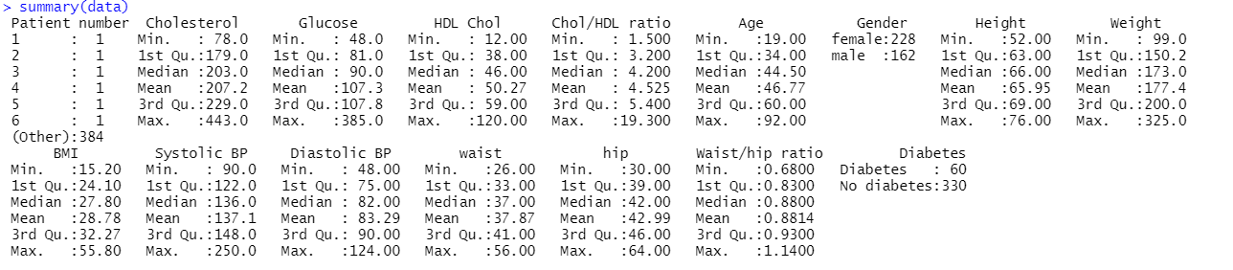
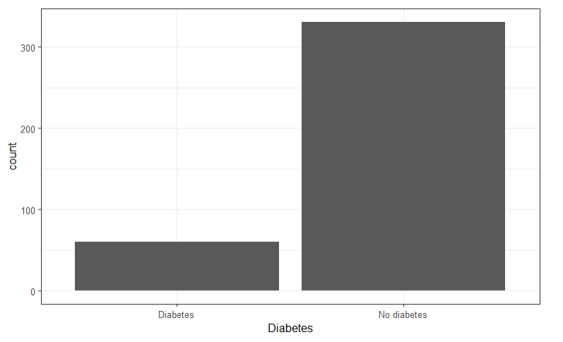
Initial Impressions and Issues That Need to be Worked Out in Coming Weeks
No missing data
Major class imbalance
Solutions could be “under-sampling”, “over-sampling”, and “stratified k-fold cross-validation”
But I plan to experiment with these methods in the next few days

Slide 11
Rough Plan For The Next Few Weeks
Make adjustments based on feedback
Use R, Rstudio, tidyverse, ISLR, and ShinyR to clean the data, explore data some more, train and experiment with algorithms, and create the application.
Use data previously mentioned to train and experiment with logistic regression, naïve bayes, support vector machines, k-nearest neighbor, and decisions trees.
After reviewing some more of my notes, I will create a more solid methods plan

Slide 12
References
CDC. (2022, September 30). Diabetes Fast Facts. Centers for Disease Control and Prevention. https://www.cdc.gov/diabetes/basics/quick-facts.html
Chang, V., Bailey, J., Xu, Q. A., & Sun, Z. (2022). Pima Indians diabetes mellitus classification based on machine learning (ML) algorithms. Neural Computing & Applications, 1–17. https://doi.org/10.1007/s00521-022-07049-z
Hoyt, Robert (2019). Diabetes Prediction [Data set]. data.world. https://data.world/informatics-edu/diabetes-prediction
Lindström, J. & Tuomilehto, J. (2003). The Diabetes Risk Score: A practical tool to predict type 2 diabetes risk. Diabetes Care, 26(3), 725–731. https://doi.org/10.2337/diacare.26.3.725

